Slide 1

SUMMER INTERNSHIIP
PROGRAM

Slide 2
Project Zomato Customer Review Prediction
TEAM NAME: Super Six
MEMBERS OF TEAM:
1.RINCY MARIAM THOMAS
2 .SIMRANPREET KAUR CHAWLA
3 .RANIA KHAN
4 .SUPRIYA PUNNA
5 .VAISHNAVI LOLLA
6 .VANDANA ADUPA

Slide 3




Slide 4
About the project:
The project demonstrates the efficiency of the app Zomato.
The user gets an instant feedback based on the review given.
The user is free to give any kind of feedback which is ensured to be taken care by the developer.
It helps the developer to know how productive the app is in different places.
It provides developer a rough statistic of the reviews stated by the customers.
The developer analyses the statistics and develops accordingly.

Slide 5
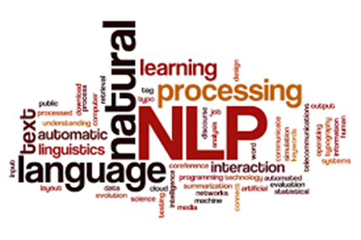
NLP:
The implementation of our project is done using Natural Language Processing(NLP) .
NLP is concerned with the interactions between computers and the human language.
It analyses large amount of natural language data.
Challenges in NLP involve speech recognition ,natural language understanding and natural language generation .

Slide 6
terminology:
Grammar Induction:
Generates a formal grammar that describes language’s syntax.
Lemmatization:
The task of removing inflectional endings only and to return the base dictionary form of a word which is also known as a lemma.
Part-of-speech tagging:
Given a sentence, determine the part of speech (POS) for each word. Many words, especially common ones, can serve as multiple parts of speech. For example, "book" can be a noun ("the book on the table") or verb ("to book a flight").

Slide 7
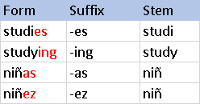
Parsing:
Determine the parse tree (grammatical analysis) of a given sentence.
Sentence breaking:
From a given a chunk of text, we find the sentence boundaries. Sentence boundaries are often marked by periods or other punctuation marks.
Stemming:
The process of reducing inflected (or sometimes derived) words to their root form. (e.g. "close" will be the root for "closed", "closing", "close", "closer" etc).

Slide 8
Terminology extraction
The goal of terminology extraction is to automatically extract relevant terms from a given corpus.
Word segmentation
Separate a chunk of continuous text into separate words.

Slide 9
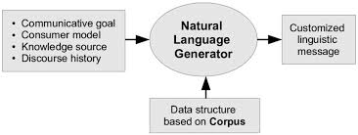
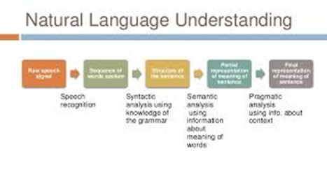
Natural language generation
Convert information from computer databases or semantic intents into readable human language.
Natural language understanding
Convert chunks of text into more formal representations such as first-order logic structures that are easier for computer programs to manipulate

Slide 10

Software Used:
Anaconda Navigator -
Anaconda Navigator is a desktop graphical user interface (GUI) included in Anaconda® distribution that allows you to launch applications and easily manage conda packages, environments and channels without using command-line commands.

Slide 11

-
Spyder, the Scientific Python Development Environment, is a free integrated development environment (IDE) that is included with Anaconda. It includes editing, interactive testing, debugging and introspection features. Spyder is also pre-installed in Anaconda Navigator, included in Anaconda.

Slide 12

Watson studio
Watson Studio provides you with the environment and tools to solve your business problems by collaboratively working with data. You can choose the tools you need to analyze and visualize data, to cleanse and shape data, to ingest streaming data, or to create and train machine learning models.
This illustration shows how the architecture of Watson Studio is centered around the project. A project is where you organize your resources and work with data.

Slide 13

libraries:
Pandas:
This library is used carry out the whole process of data analysis and data modeling which was not possible in python priorly.
Pandas allows us to focus much on research and less on programming . In this way it becomes very easy to learn. The bottom line is that it has increased our productivity.
We use pandas to process time series data on our production servers.
The simplicity and elegance of its API, and its high level of performance for high-volume datasets, made it a perfect choice for us.

Slide 14
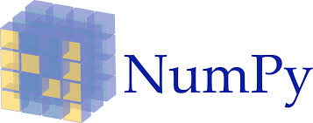
NumPy:
NumPy is a Python package which stands for 'Numerical Python'. It is a library consisting of multidimensional array objects and a collection of routines for processing of array.
NumPy is the fundamental package for scientific computing with Python.
Besides its obvious scientific uses, NumPy can also be used as an efficient multi-dimensional container of generic data.
Arbitrary data-types can be defined. This allows NumPy to seamlessly and speedily integrate with a wide variety of databases.

Slide 15
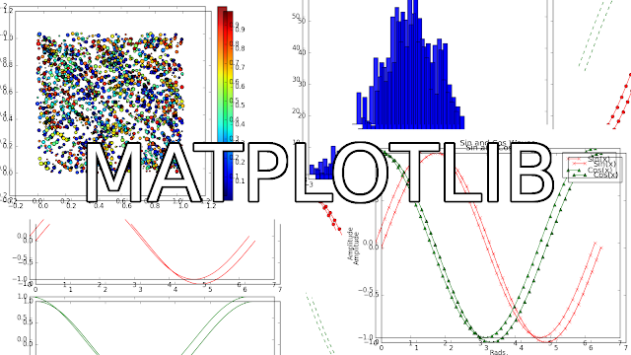
Matplotlib:
Matplotlib is an amazing visualization library in Python for 2D plots of arrays.
Matplotlib is a multi-platform data visualization library built on NumPy arrays and designed to work with the broader SciPy stack.
One of the greatest benefits of visualization is that it allows us visual access to huge amounts of data in easily digestible visuals.
Matplotlib consists of several plots like line, bar, scatter, histogram etc.

Slide 16

Keras:
Keras is a minimalist Python library for deep learning that can run on top of Theano or TensorFlow.
It was developed based on four principles-
Modularity: A model can be understood as a sequence or a graph alone. All the concerns of a deep learning model are discrete components that can be combined in arbitrary ways.
Minimalism: The library provides just enough to achieve an outcome, no frills and maximizing readability.
Extensibility: New components are intentionally easy to add and use within the framework, intended for researchers to trial and explore new ideas.
Python: No separate model files with custom file formats. Everything is native Python.

Slide 17
Pickle:
This library is used for serializing and de-serializing a Python object structure.
Any object in python can be pickled so that it can be saved on disk. What pickle does is that it “serialises” the object first before writing it to file.
Pickling is a way to convert a python object (list, dict, etc.) into a character stream.
The idea is that this character stream contains all the information necessary to reconstruct the object in another python script.

Slide 18
Tkinter:
The Tkinter module (“Tk interface”) is the standard Python interface to the Tk GUI toolkit.
Tkinter is not the only GuiProgramming toolkit for Python. It is however the most commonly used one.
The Tk interface is located in a binary module named _tkinter. This module contains the low-level interface to Tk, and should never be used directly by application programmers.
It is usually a shared library (or DLL), but might in some cases be statically linked with the Python interpreter.

Slide 19
Code description:
Firstly the libraries such as pandas, numPy, matplotlib, pickle and tkinter are imported.
Then a dataset was created based on the customer reviews which mainly had three columns - reviews, liked and cities.
The model was initially trained and then tested using the dataset.
UI’s were created , one for the customer’s feedback and other for the developer ‘s analysis.
The customer’s UI is composed of label, text and buttons whereas the developer’s UI consists of piecharts and bargraphs .
The reviews are examined and are differentiated as positive or negative comments using the dataset.

Slide 20
RESULt:
The set of reviews surveyed from the cities are categorized as positive and negative .
Then comments are represented visually in the form of piecharts and bargraphs.
The visualized part is appeared on the developer’s UI.
This gives the clear picture to the developer of how efficient and reliable the app is.

Slide 21
Advantages:
Through the predictions we make the developer of the Zomato app would able to know their drawbacks.
When any customer gives any review the developer would be able to improvise their services.
Through the prediction we are creating an interface between the user and the developer which is a boon to the developer of the app

Slide 22
disadvantages
When a user who is not well versed of this tries to give a review which is not correct then the machine might not be able to detect if it is a positive or a negative review. It gives wrong output.

Slide 23
Scope:
In future, this project can be further applied to analyse the statistics of particular app and develop accordingly.
This project can be considered as a base and can be implemented to various apps irrespective of the fields which makes their work simpler and productive.
It improves the efficiency of the app.

Slide 24


